Slide 1

Financial Performance Dashboard
EGX: EFID · POWER BI PROJECT
Is Edita growing profitably, and is it sustainable?
Moawia Mohamed · Entry-Level Data Analyst

Slide 2
Raw statements do not say if growth is sustainable
THE PROBLEM AND WHAT I BUILT
Problem solved
What I built
Edita reports 20 quarters of income, balance sheet and cash flow data. On their own, the numbers do not show whether growth is profitable, funded safely, or turning into cash.
A Python ETL that collects quarterly statements from Stock Analysis into one Excel file (196 EGX companies, 215,925 rows), then an Edita extract for Power BI.
Business question
Dashboard
Is Edita growing profitably, and what could slow it down?
6 pages with DAX measures for growth, margins, funding, liquidity, working capital and risk.

Slide 3
Six pages, one business question each
DASHBOARD PAGES
# | Page | Question it answers
1 | Overview | How is the company performing financially?
2 | Profit & Loss | Is the company growing profitably?
3 | Balance Sheet | What does it own, and how is it funded?
4 | Liquidity & Leverage | Can it meet its obligations?
5 | Working Capital | How efficiently does it use operating assets?
6 | Risks & Takeaways | What problem did the analysis find, and what to do?

Slide 4
One meaning per color
COLORS USED
Black #111111
Gray #6B6B6B
Orange #E8730C
Text and main series
Secondary series
Focus and key numbers
Red #C0392B
Light orange #F6B26B
Light gray #CFCFCF
Risks and warnings
Cost shares
Gridlines and thresholds

Slide 5
Every page follows the same story pattern
PAGE LAYOUT
1 Header
2 Headline
Black bar with the Edita logo, page names and one Year slicer (All, 2024, 2025, 2026).
Chapter number and a headline that states the finding, with the question below it.
3 KPI column
4 Charts
Four cards on the left, each with an icon, one value in black and a short context line.
One main chart and two supporting charts; every title is a question.
5 So what
6 Reading rules
A closing strip with the conclusion. Risks use a red outline.
One unit per number, partial years labeled, one meaning per color.

Slide 6
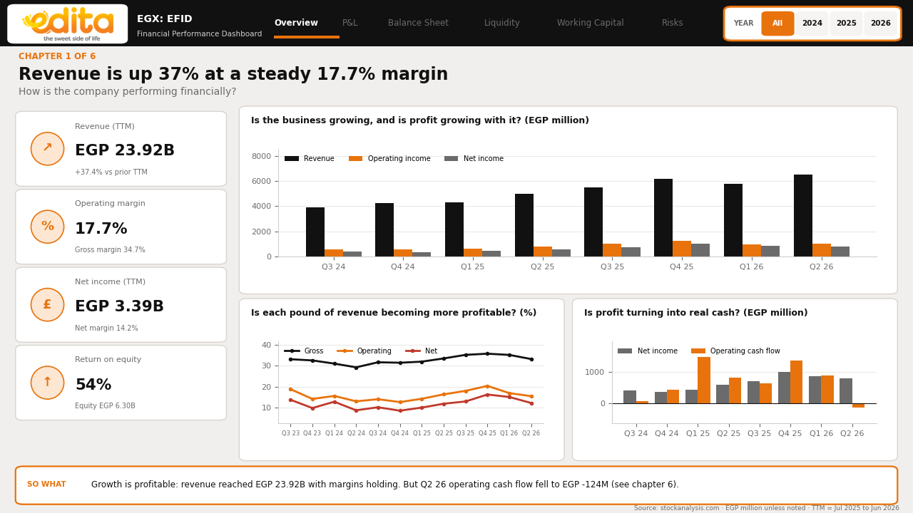
Revenue is up 37% at a steady 17.7% margin
PAGE 1 · OVERVIEW
KPIs
Revenue EGP 23.92B (+37.4%), operating margin 17.7%, net income EGP 3.39B, ROE 54%.
Charts
Columns for revenue, operating and net income; margin lines; net income against operating cash flow.
What I learned
Growth is profitable, but Q2 26 operating cash flow fell to EGP -124M while net income was EGP 796M.

Slide 7
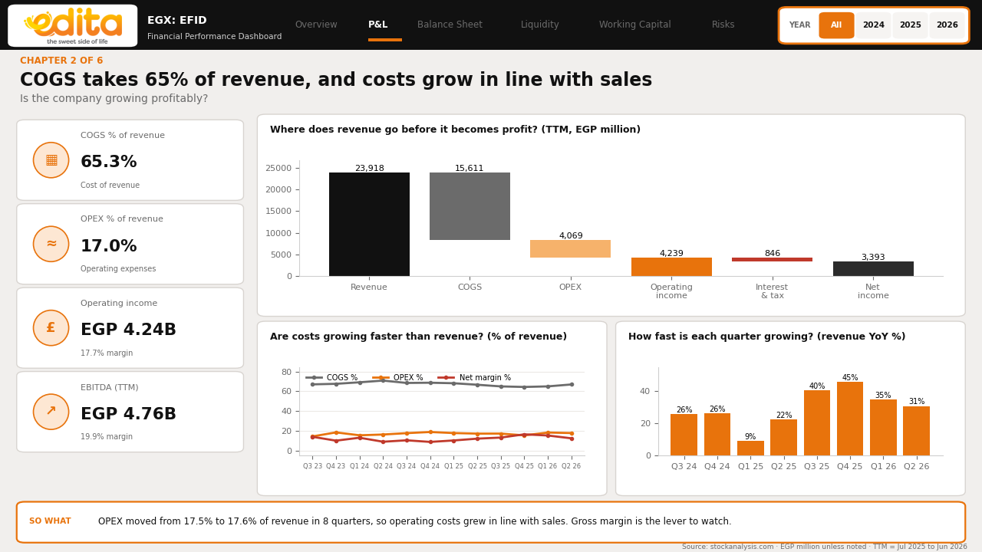
COGS takes 65% of revenue and costs grow with sales
PAGE 2 · PROFIT & LOSS
KPIs
COGS 65.3% and OPEX 17.0% of revenue, operating income EGP 4.24B, EBITDA EGP 4.76B.
Charts
A waterfall from revenue to net income, cost shares by quarter, and revenue growth by quarter.
What I learned
OPEX moved only from 17.5% to 17.6% in 8 quarters, so gross margin is the lever to watch.

Slide 8
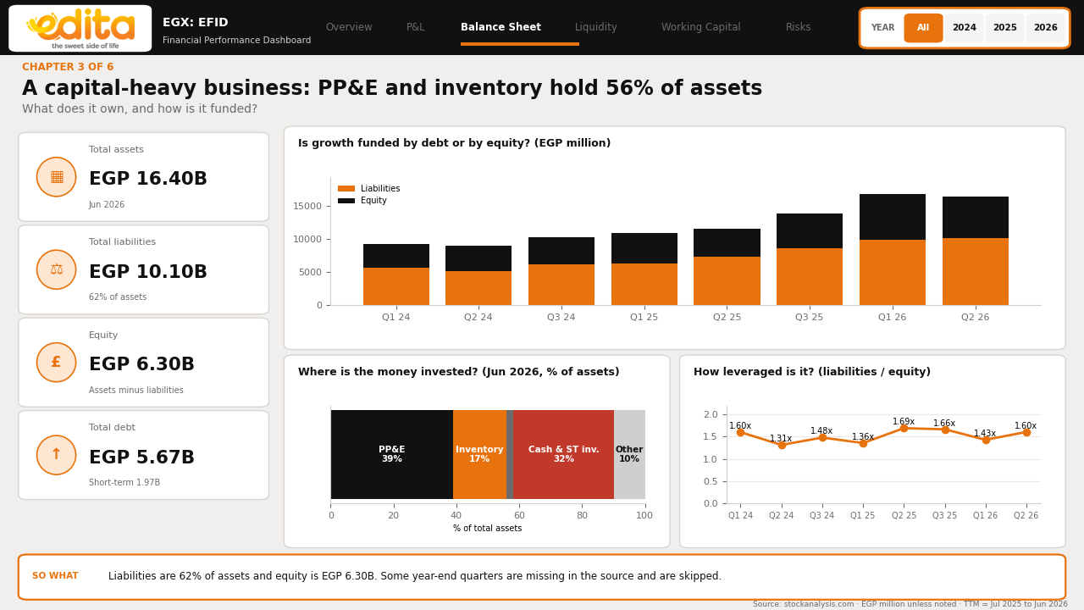
PP&E and inventory hold 56% of assets
PAGE 3 · BALANCE SHEET
KPIs
Assets EGP 16.40B, liabilities EGP 10.10B (62%), equity EGP 6.30B, debt EGP 5.67B.
Charts
Liabilities against equity by quarter, the asset mix, and liabilities to equity.
What I learned
Edita is capital and stock heavy, with liabilities at 1.60x equity.

Slide 9
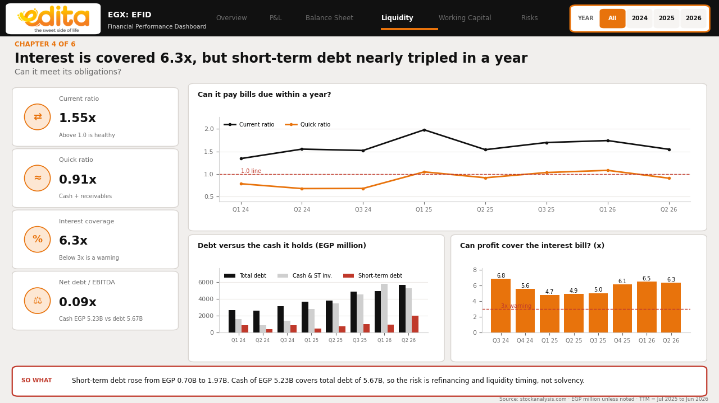
Interest is covered 6.3x, but short-term debt nearly tripled
PAGE 4 · LIQUIDITY & LEVERAGE
KPIs
Current ratio 1.55x, quick ratio 0.91x, interest coverage 6.3x, net debt to EBITDA 0.09x.
Charts
Current and quick ratios against 1.0, debt against cash, and coverage against the 3x warning.
What I learned
Short-term debt rose from EGP 0.70B to 1.97B, but cash of EGP 5.23B covers total debt, so the risk is timing, not solvency.

Slide 10
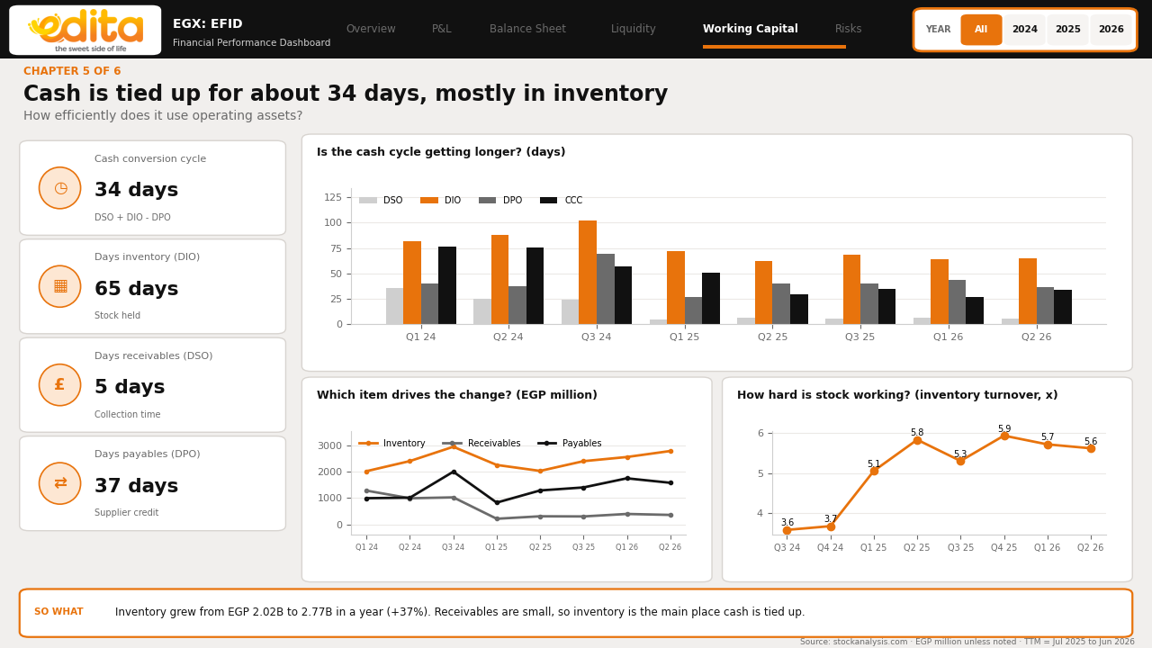
Cash is tied up for about 34 days, mostly in inventory
PAGE 5 · WORKING CAPITAL
KPIs
Cash cycle 34 days: inventory 65, receivables 5, payables 37.
Charts
Days by quarter, inventory against receivables and payables, and inventory turnover.
What I learned
Inventory grew from EGP 2.02B to 2.77B in a year (+37%), the main place cash is tied up.

Slide 11
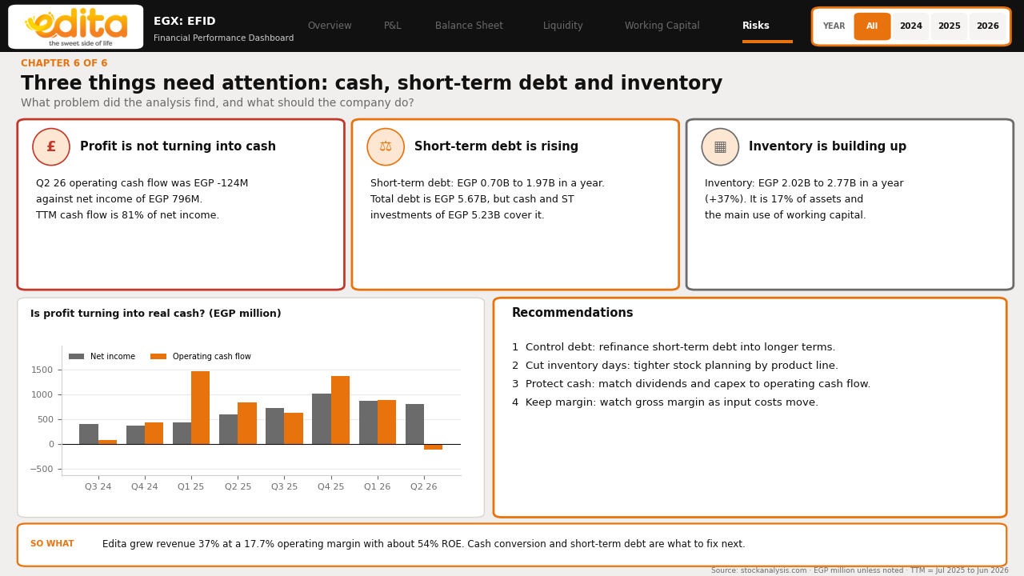
Three things need attention: cash, short-term debt, inventory
PAGE 6 · RISKS & TAKEAWAYS
KPIs
Three problem cards and four recommendations.
Charts
Net income against operating cash flow by quarter.
What I learned
Control debt, cut inventory days, and match dividends and capex to operating cash flow.

Slide 12
Start from the business question, then build
WHAT I LEARNED
Finding
Risk
Skill
Revenue grew 37% at a 17.7% operating margin with about 54% ROE.
Cash conversion weakened and short-term debt rose, though cash covers total debt.
Ask the business question first, then pick the KPIs and charts that answer it.

